Slide 1



A Feasibility Study on the Expansion of Health Smartwatches Beyond California
Ezekiel Adriel D. Lagmay
Which one (or two) states should be prioritized in the
expansion of the Health Smartwatch business?

Slide 2
Project description
Business Questions:
How does the level of state income impact property prices?
How does the level of healthcare spending vary between states, and which states spend the most/least per person?
How does the average spending on healthcare-related products and services per person vary between states with different levels of corruption?

Slide 3
Project description
Description of Dataset
Competitor companies’ profit and expenditures - This contains the total profit and the costs incurred for research and development, marketing, and administration per state and competitor.
Corruption conviction per capita - This is the number of convictions per population per state.
Health spending - The average, minimum, and maximum health spending per person per state.
Property prices - The average, minimum, and maximum property price per square meter per state.
State income - The average, minimum, and maximum income per state.
Population - The total population per state (this includes District of Columbia, which is not part of the other datasets and is hence excluded from the analysis).

Slide 4
Project description
Steps in Analyzing the Data
PostgreSQL
Top 5 states with the highest and lowest total health spending (average health spending per person * total population).
Join competitor dataset with the health spending dataset to see if there is any correlation between health spending per state and profit.
Also used for joining health spending with population dataset, and for joining property price with average competitor profit for analysis via Excel, Power BI, and Python.

Slide 5
Project description
Steps in Analyzing the Data
Excel
Created a pivot table to show the total health spending per state (average health spending per person * total population)
Used conditional formatting to highlight the top 5 states with the highest health spending per person.
Created a scatter plot to visualize the correlation between property prices and company profit.
Created a scatter plot to show the correlation between health spending per person and state income.

Slide 6
Project description
Steps in Analyzing the Data
Power BI
Created a bar chart to show the health spending per state.
Used a map visualization to highlight the top 10 states with the highest health spending per person.
Created a correlation matrix to see if there is any correlation between property prices and profit.
Calculated Financial Viability Metrics from Competitor Companies, including Average Total Revenue, Average Total Cost, Average Total Profit, Average Net Profit Margin, and Average Breakdown of Costs.

Slide 7
Project description
Steps in Analyzing the Data
Python
Used Pandas to find the top 5 states with the highest health spending per person.
Used Matplotlib and/or Seaborn to create a bar chart to show the health spending per state.
Used Matplotlib and/or Seaborn to create a scatter plot to visualize the correlation between property prices and profit.
Created a scatter plot to show the correlation between property prices and state income.
Group states based on corruption level, health spending, and property prices.

Slide 8
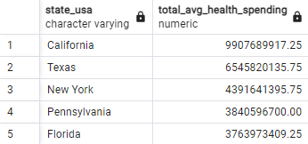
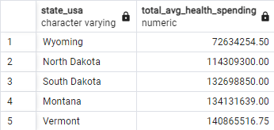
Postgres

Slide 9
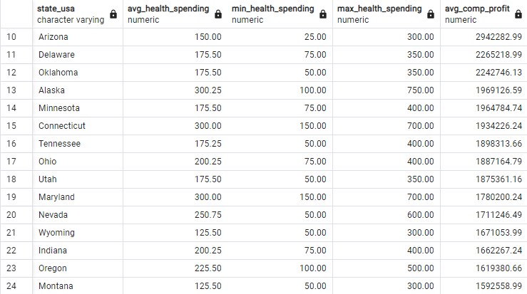
Postgres

Slide 10
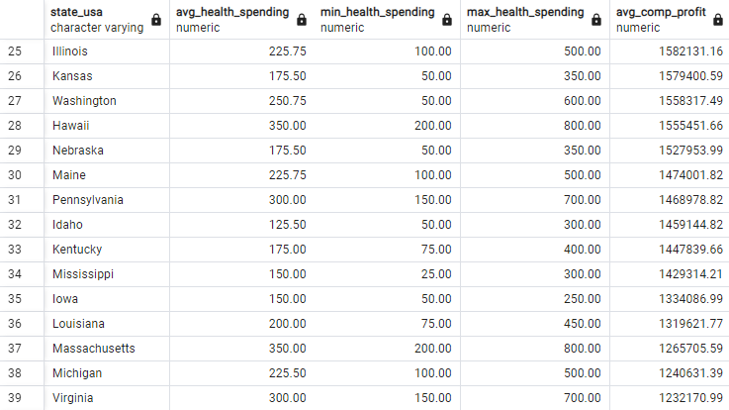
Postgres

Slide 11
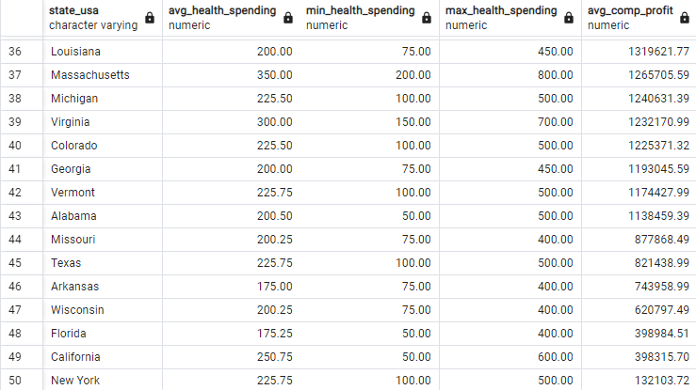
Postgres

Slide 12
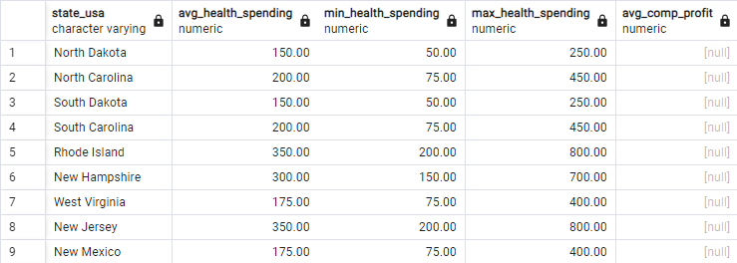
Postgres

Slide 13
Postgres
Short conclusion:
Except for Pennsylvania, the states with the highest total health spending have the lowest average competitor profit.
The hypothesis: The greater the health spending per person, the less average profit per competitor.

Slide 14
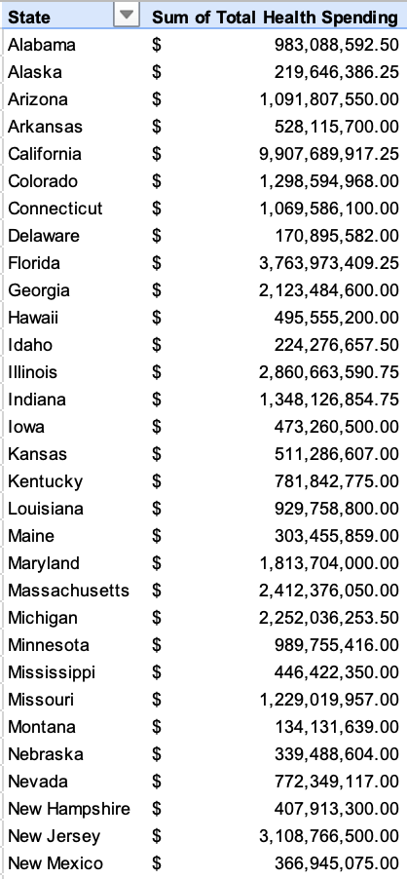
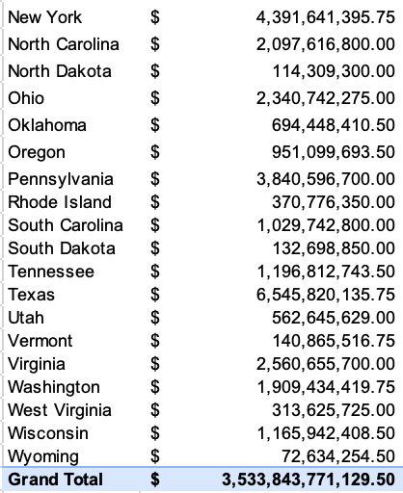
Excel

Slide 15
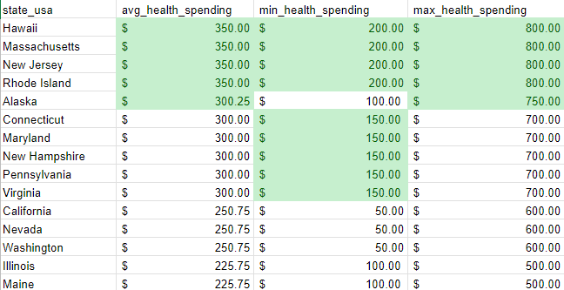
Excel

Slide 16
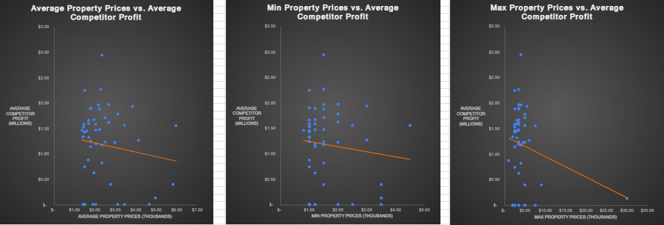
Excel

Slide 17
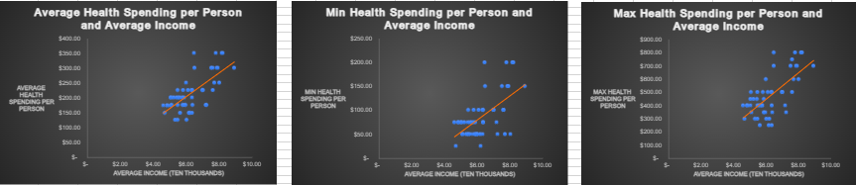
Excel

Slide 18
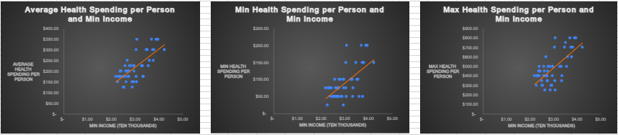
Excel

Slide 19
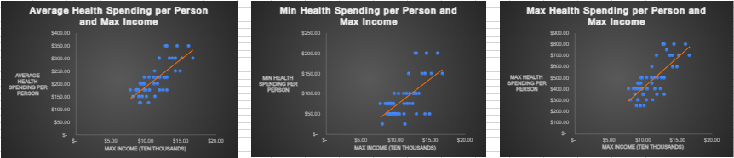
Excel

Slide 20
Excel
Short conclusion:
Property Prices, most especially Max Property Prices, are negatively correlated with Average Competitor Profit.
Health Spending per Person is positively correlated with Income.

Slide 21
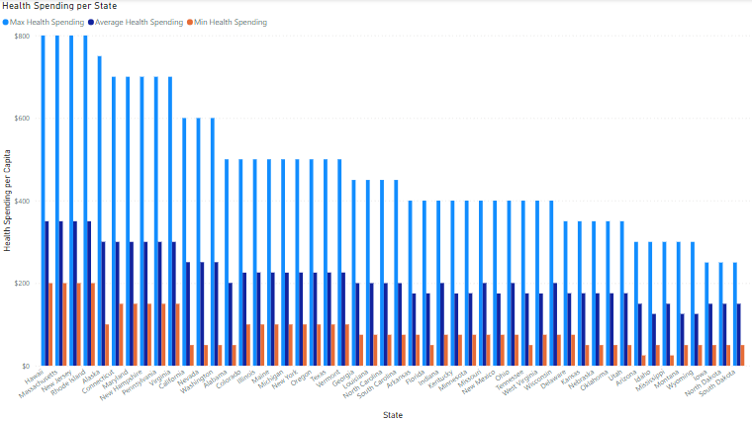
Power BI

Slide 22
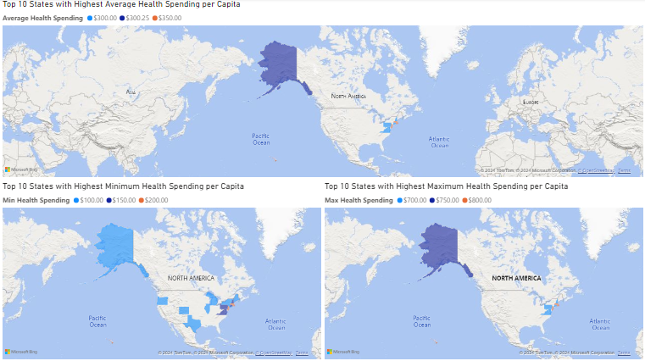
Power BI

Slide 23

Power BI

Slide 24
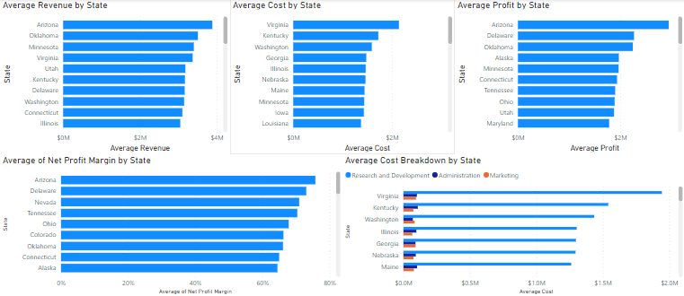
Power BI

Slide 25
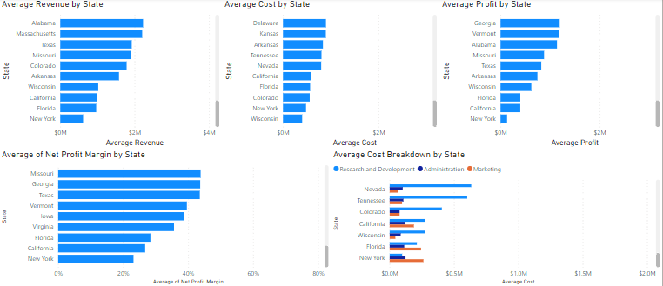
Power BI

Slide 26
Power BI
Short conclusion:
In general, most of the states with the highest health spending per person, regardless whether it’s average, min, or max, are in the Northeast Region of the United States (except Alaska and Hawaii).
Property Price is negatively correlated with Average Competitor Profit.
Except for New York and Florida, most of the Average Competitor Cost is for Research and Development. In the case of New York and Florida, much of it is for Marketing.

Slide 27
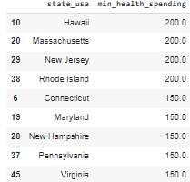
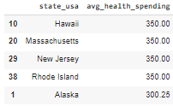
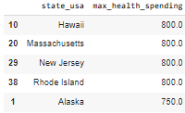
Python

Slide 28
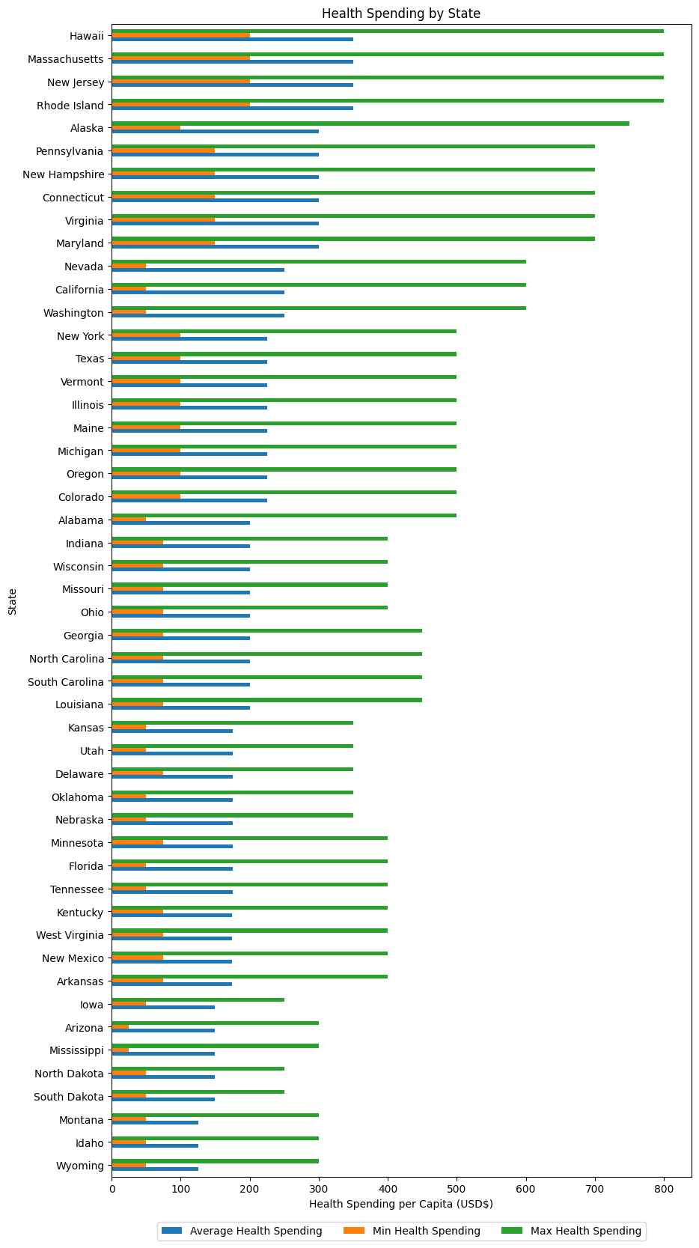
Python

Slide 29
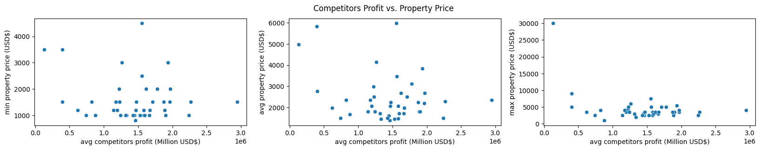
Python

Slide 30
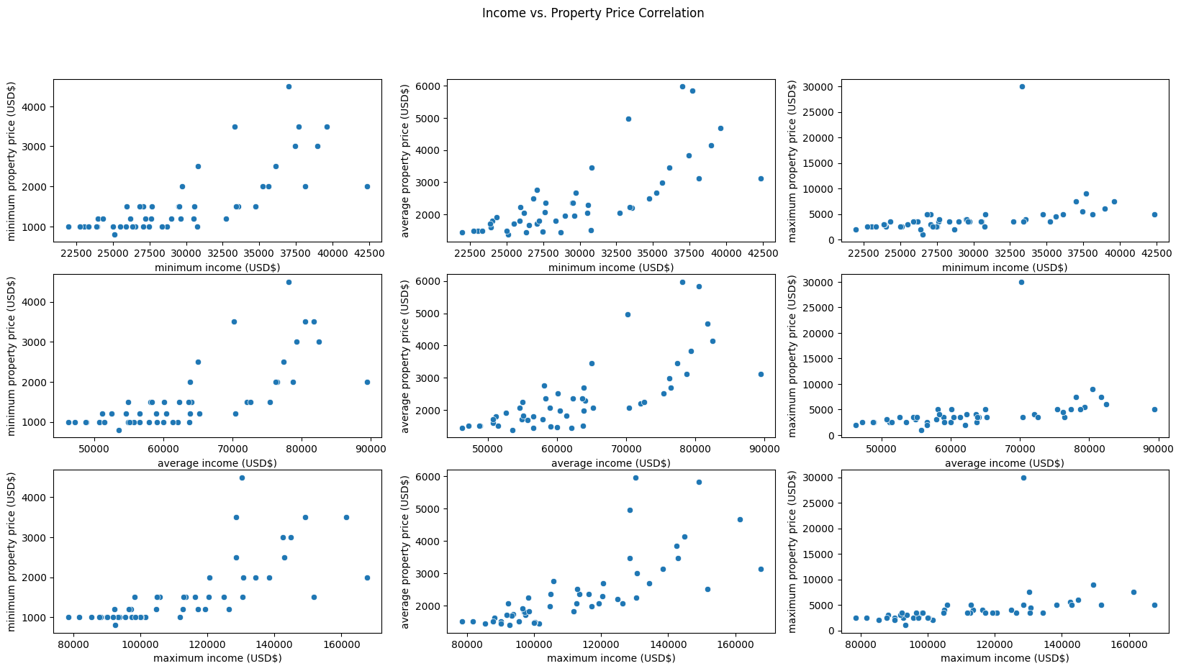
Python

Slide 31
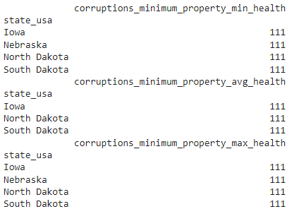
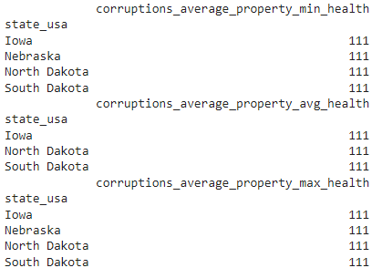
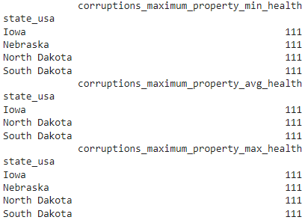
Python

Slide 32
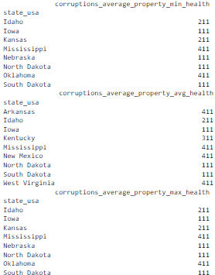
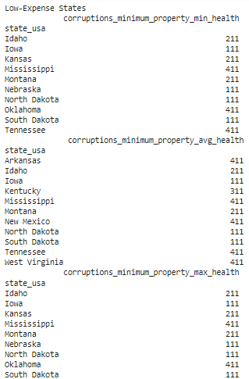
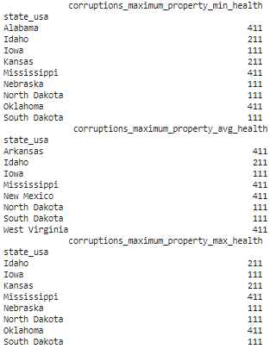
Python

Slide 33
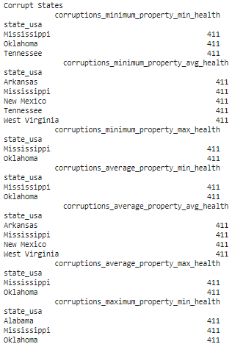
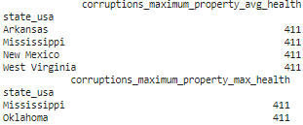
Python

Slide 34
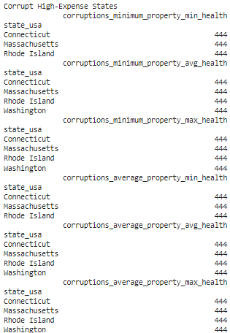
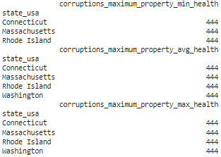
Python

Slide 35
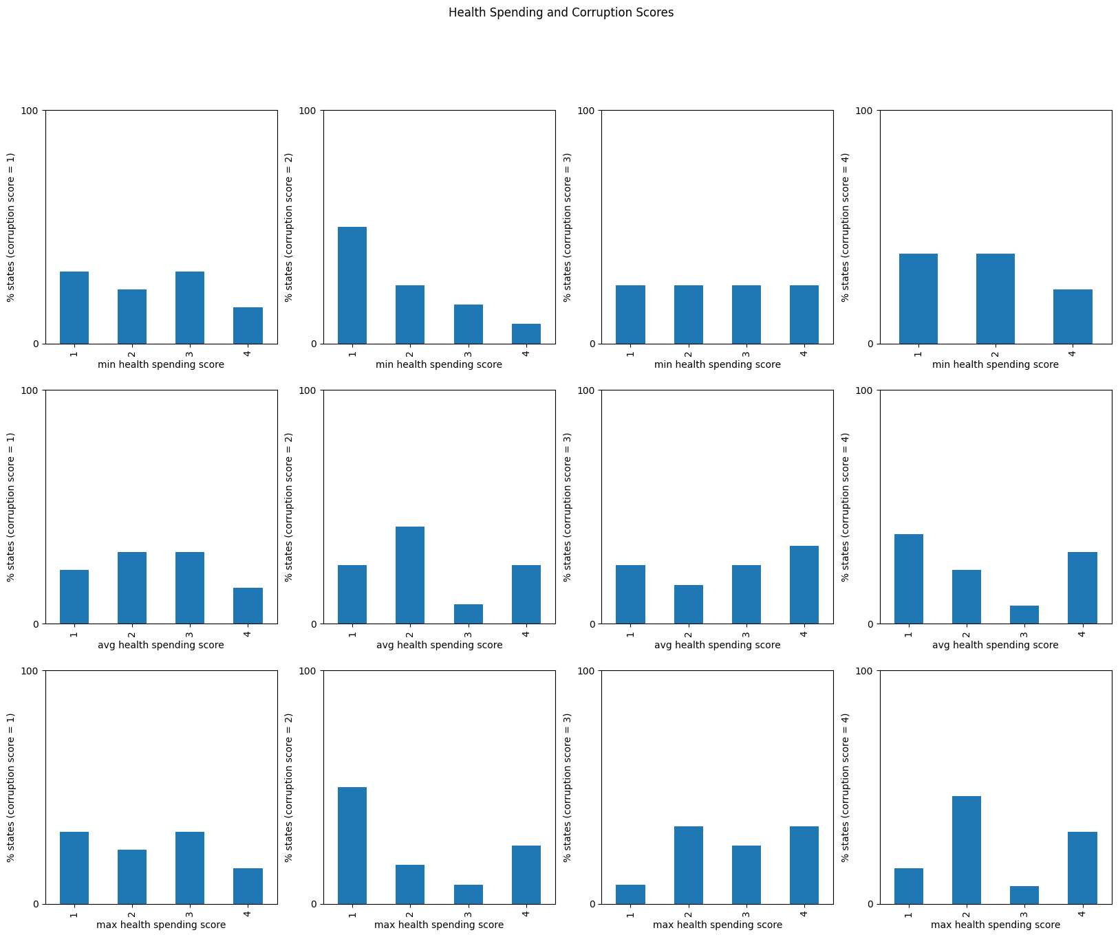
Python

Slide 36
Python
Short conclusion:
Income and Property Price are positively correlated.
Iowa, North Dakota, and South Dakota are the best states in terms of costs of living (health spendings and property price) and corruption rates, but North Dakota and South Dakota don’t have any competitor information while Iowa is among the states with the highest competitor cost (and hence low net profit margin).
In general, the worse the corruption rate, the higher the percentage of states that have high costs of living.

Slide 37
Conclusion
Summary of Findings
The main finding in this study is that Property Prices are negatively correlated with Average Competitor Profit, Health Spending is positively correlated with Income, and Property Prices are positively correlated with Income.
=> Health Spending is positively correlated with Property Prices and negatively correlated with Average Competitor Profit.

Slide 38
Conclusion
Insights
One possible reason behind the negative correlation between health spending, property prices, and income with average competitor profit is that as that as income increases, the cost of living may also increase (possibly due to inflation, see https://www.investopedia.com/ask/answers/111314/what-causes-inflation-and-does-anyone-gain-it.asp#:~:text=Higher%20wages%20also%20increase%20consumers,the%20other%20and%20vice%2Dversa.), causing people to prioritize spendings related to basic needs like health and shelter (property) rather than smartwatches. Consequently, competitor profit may decrease.

Slide 39
Conclusion
Answers to Business Questions
Aside from the negative relationship between income and property, and ultimately health spending, we also found out that:
The states with the highest health spending per person are in the Northeastern US (New Jersey, Rhode Island, Massachusetts), Alaska, and Hawaii.
The states with the lowest health spending per person are North Dakota, South Dakota, Idaho, Mississippi, Arizona, Montana, Wyoming, and Iowa.
A higher percentage of states with high health spendings are noted for more corrupt states than for less corrupt states.

Slide 40
Conclusion
Recommendations
Based from the findings presented, the recommendation would be to prioritize states with low health spending per person, property price, and corruption for the expansion efforts of the smartwatch business.
Since Iowa has high competitor costs, North Dakota and South Dakota fits this description very well, however…

Slide 41
Conclusion
Challenges Encountered During the Analysis
North Dakota and South Dakota are among the states with no competitor cost and profit information available. While it may be logical to entirely remove those states in the analysis, that might also mean losing other vital information about these states.
This could mean either two things:
The competitors have not expanded into those states. If this is the case, expanding into those states, given the right conditions, would potentially be profitable for the company.
Competitors have expanded into those states, but information was not available. Efforts should be made in this case to obtain competitor information so as to get more accurate correlations and results.

Slide 42
Conclusion
Recommendations for Future Research
Future researches may focus on the following research questions:
How does the breakdown of healthcare spending by state and category vary across the country, and what are the implications for resource allocation?
How do a state's average income and population size affect the average spending on healthcare-related products and services per person?
Is there a correlation between a state's level of corruption and its competitor companies' profits?

